Slide 1

Evaluation of Various Sensing Modalities for Accurate Measurement of Neck Flexion Angle during Thyroid and Ear Surgery
CIS II Project
Team Member : Zhen Hu, Hanqing Duan
Mentor: Dr. Russell Taylor, Dr. Deepa Galaiya

Slide 2
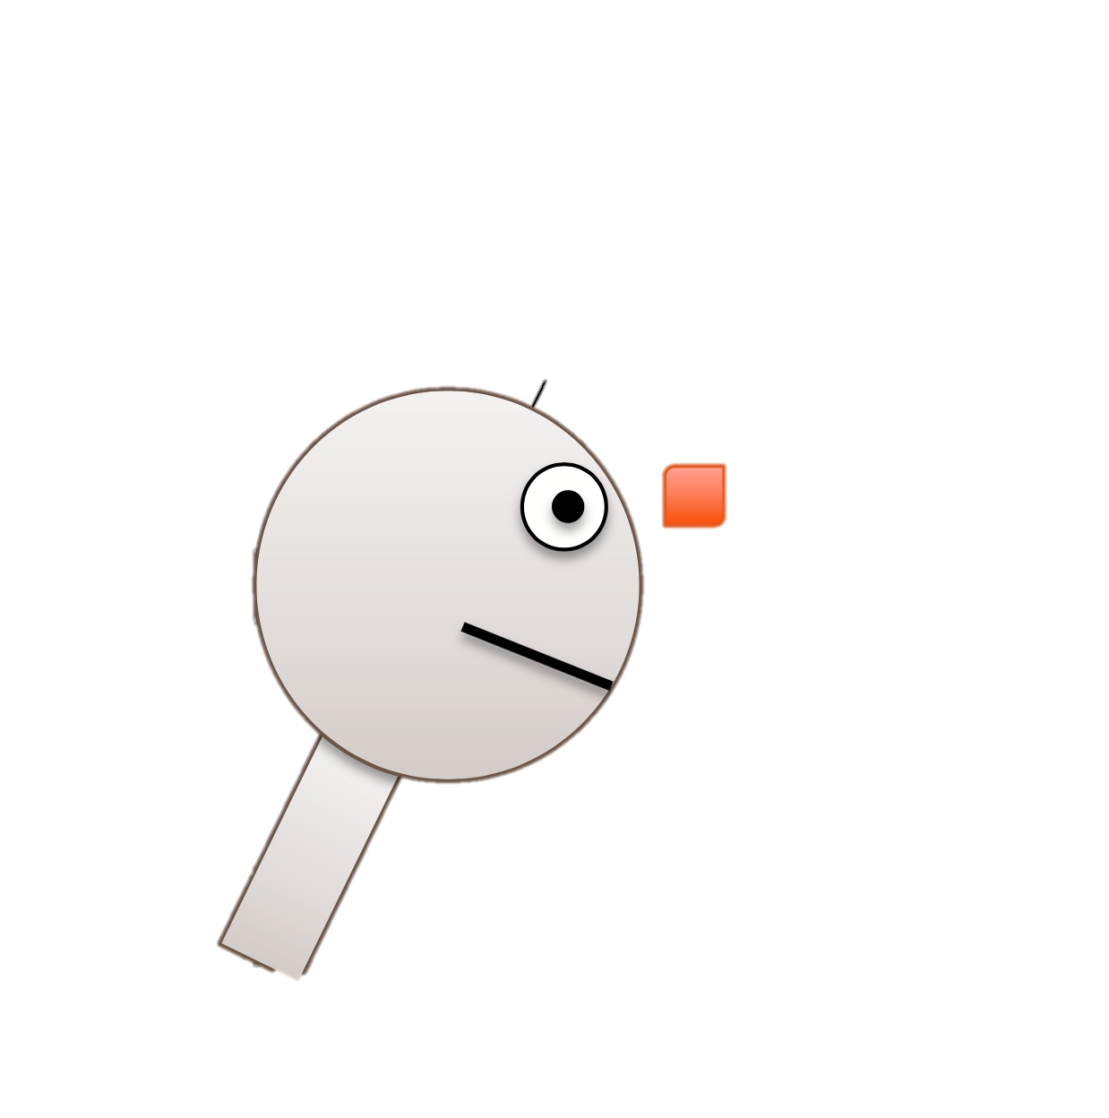
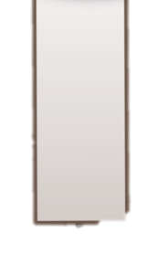


Project Review
Last week:
Finish processing the calibration data
Finish processing the Mock OR data
$$θ$$

Slide 3
Calibration Data
The measurement result from EM tracker | The measurement result from IMU 1A | The measurement result from IMU A6
3.8810 | 4.1524 | 3.8791
15.5105 | 15.8083 | 15.3880
26.6346 | 27.6527 | 27.6778
32.6116 | 33.3907 | 33.4102
37.8730 | 38.5087 | 38.4184
42.1996 | 42.6490 | 42.52
45.7238 | 46.0262 | 45.8209
48.4941 | 48.6611 | 48.4686
50.2905 | 50.4428 | 50.2339
52.8936 | 53.3970 | 53.1683

Slide 4
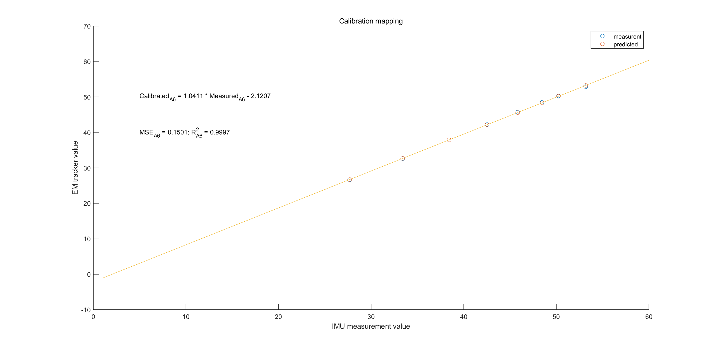
Calibration Result: A6
Linear Regression

Slide 5
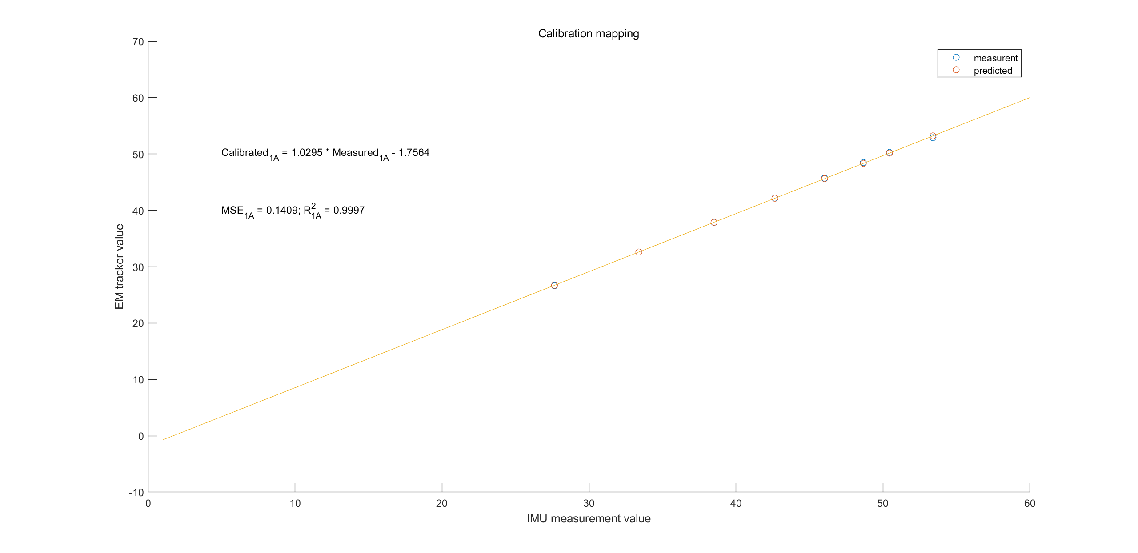
Calibration Result: 1A
Linear Regression

Slide 6
Mock OR data analysis
Method:
For standard case:
Average quaternion from two IMUs separately when surgeon stands.
For every other cases:
1. Calculate the angle between the quaternion from IMU-A6 and the quaternion in standard case;
2. Calculate the angle between the quaternion from IMU-1A and the quaternion in standard case;
3. Use the linear regression function to do the calibration;
4. Calculate the difference angle between two calibrated angles from IMU-A6 and IMU-1A.

Slide 7
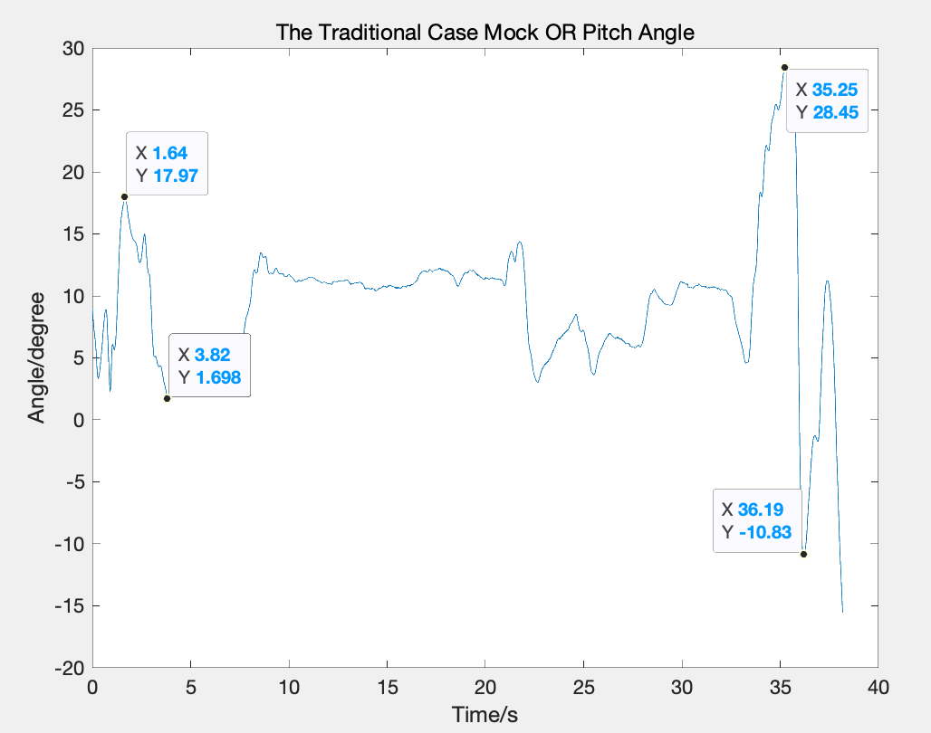
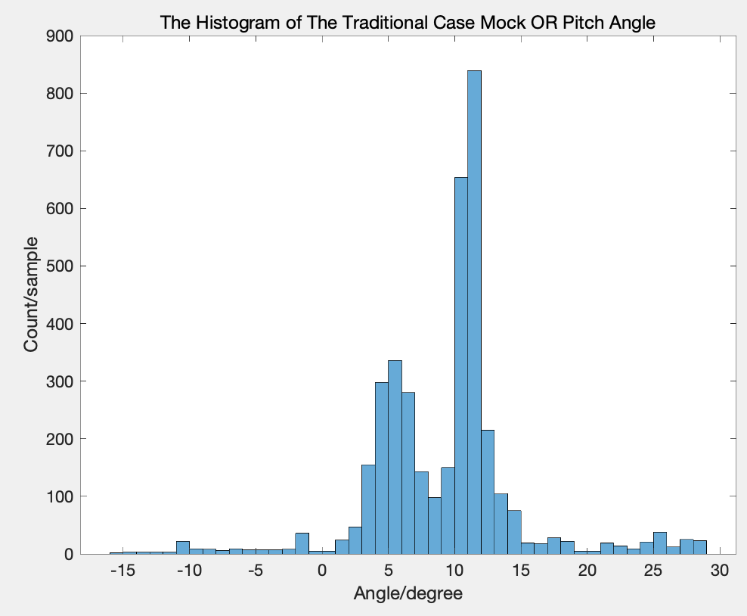
Traditional Case
Most angles are in the the range: (5,13) degree

Slide 8
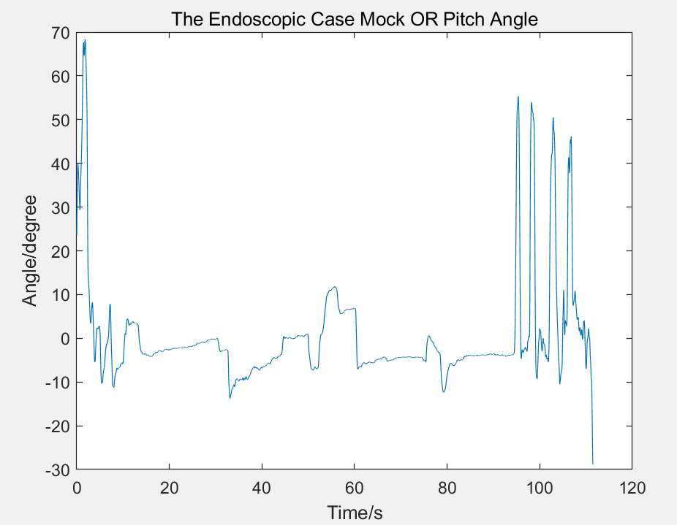
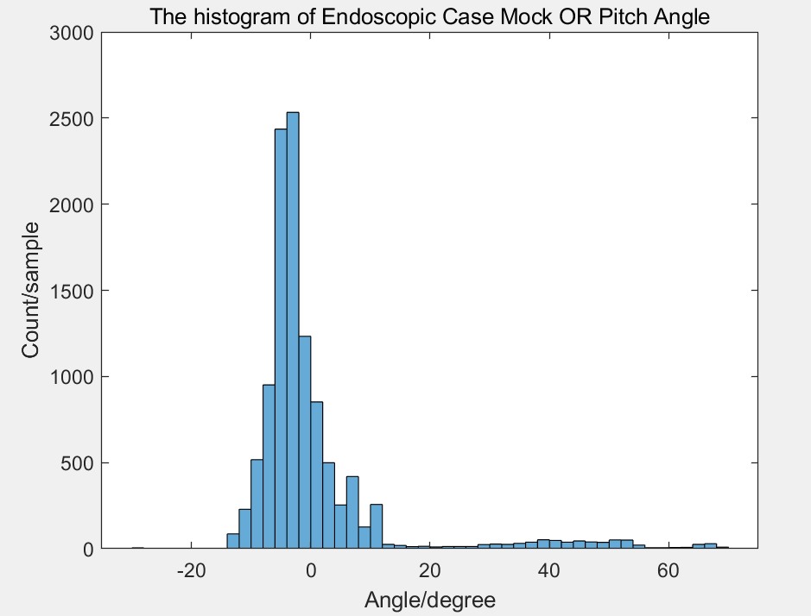
Endoscopic Case
Most angles are in the the range: (-10,10) degree

Slide 9
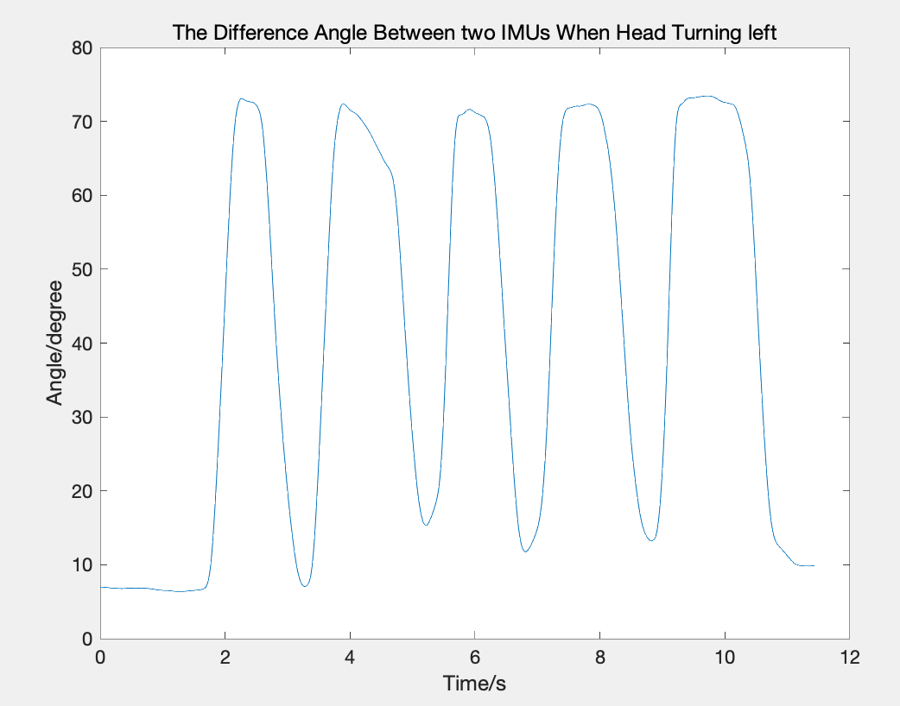
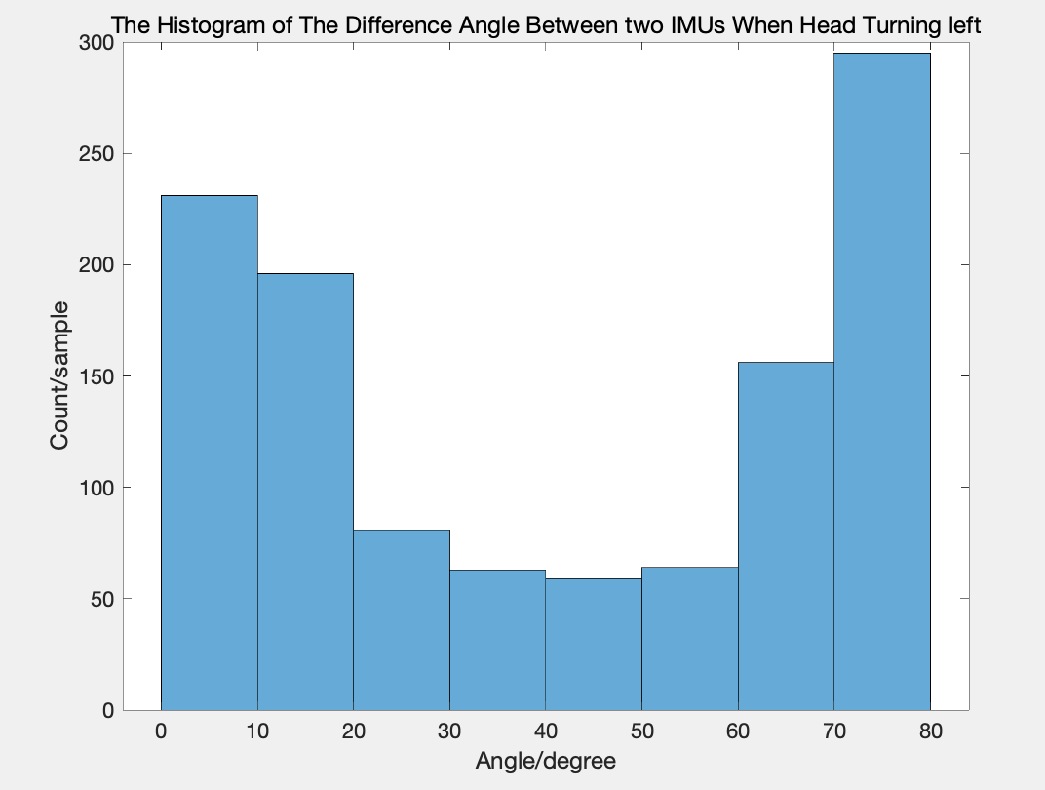
When Head turn left
Question: This kind of movement will also influence our pitch angle result. How could we minimize this influence?

Slide 10
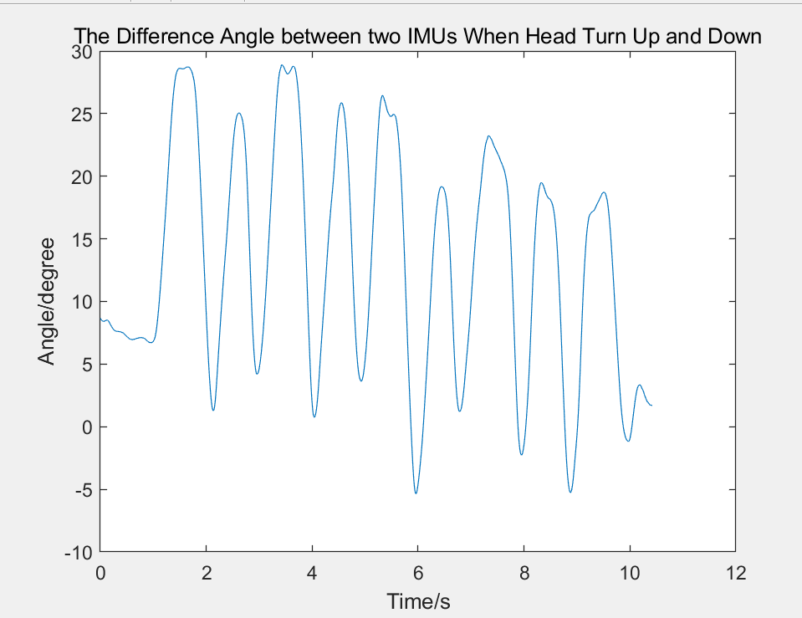
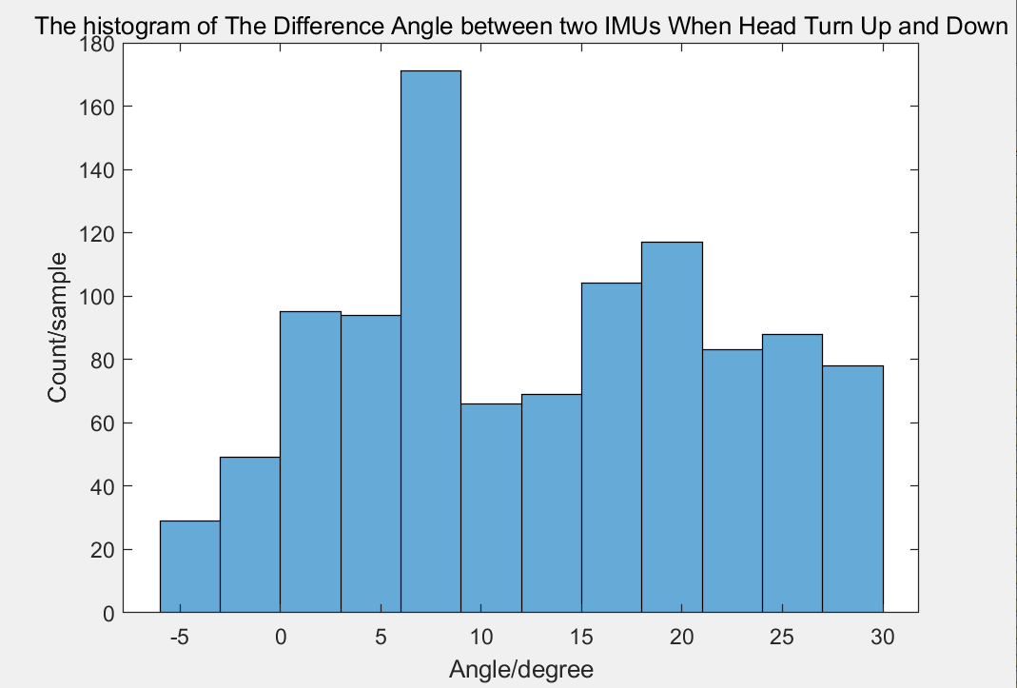
When Head Up and Down

Slide 11
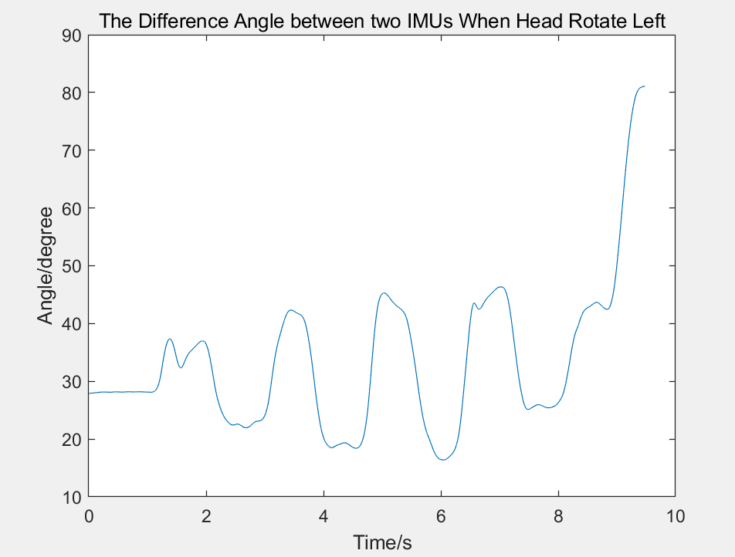
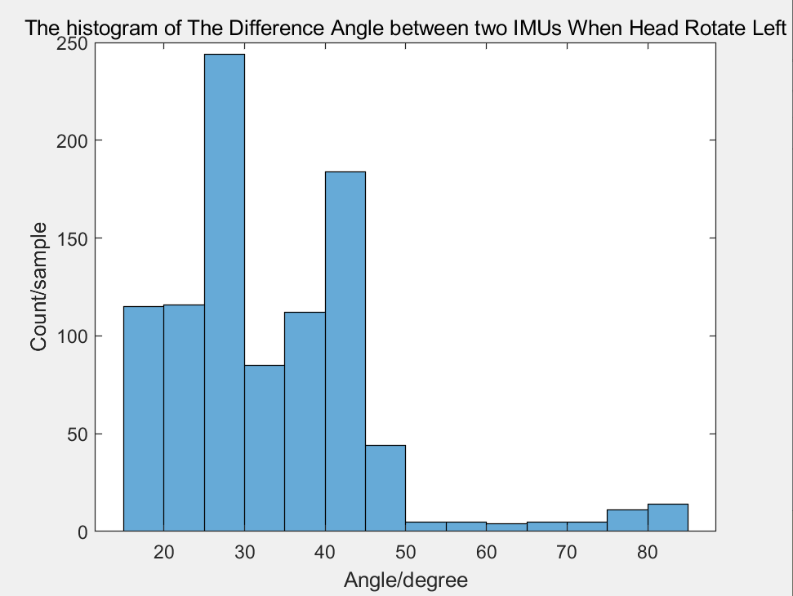
When Head Rotate to Left

